Slide 1
Content Aware Resizing of Images
Greg Merritt, Andrew Novicki, Jinyuan Zhao

Slide 2


Problem
Often, images need to be resized to properly fit on a display. Brute force resizing of the image can lead to objects of interest losing focus to background.
Our goal is to resize an n x m image to n’ x m’, while still preserving the visual coherence.
Resized by scaling
Original
Content Aware Resizing (ideal)

Slide 3
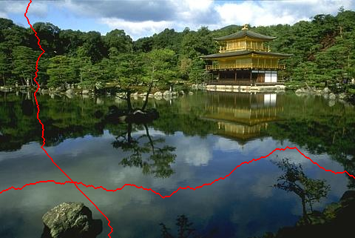
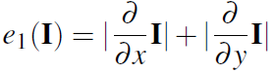
Seam Carving Method of Image Resizing
The image is divided into vertical and horizontal seams:
The energy of each seam is computed:
The seam with the minimum energy is then found, and the image can be expanded or squeezed by duplicating or removing the seam with the minimum energy.
The image is resized in the x direction, followed by the y dimension by this method
Example horizontal and vertical seam

Slide 4

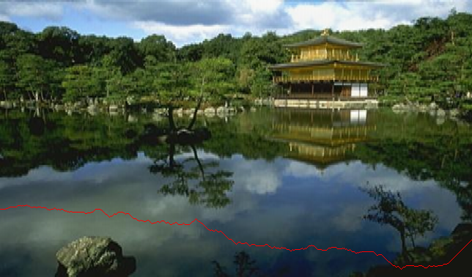

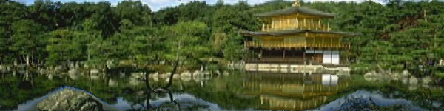
Seam Carving Method of Image Resizing
Original (644x378)
Resized (600x150)

Slide 5
Image Shrinking
Original
512x512
Output
400x400

Slide 6
Image Enlarging
Original
512x512
Output
400x400

Slide 7

Using Proper Images
Single subject
Minimum Energy Seams are easy to identify
Many objects
Minimum Energy seams are difficult to identify

Slide 8

Using Proper Images
Main objects keep their shape
Main objects are distorted

Slide 9
Further Work
Detect whether to resample the image using conventional methods or using the seam-carving method

